Slide 1
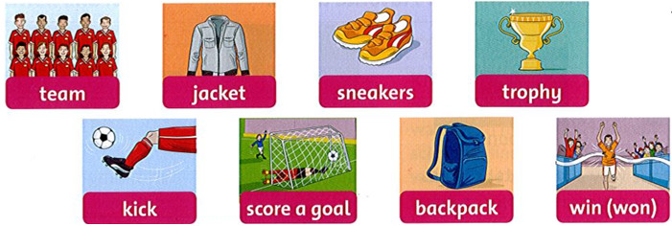
Friday , December 4th 2021 Unit 5: Lesson 1
1. Listen, point, and repeat.
Click here to listen

Slide 2
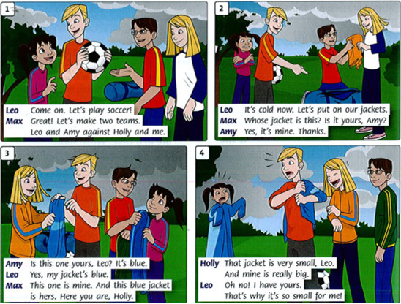
2. Listen and read.
Click here to listen

Slide 3
1. Leo: Come on. Let's play soccer!
Max: Great! Let's make two teams. Leo and Amy against Holly and me.
2. Leo: It's cold now. Let's put on our jackets.
Max: Whose jacket is this? Is it yours, Amy?
Amy: Yes, it's mine. Thanks.
3. Amy: Is this one yours, Leo? It's blue.
Leo: Yes, my jacket's blue.
Max: This one is mine. And this blue jacket is hers. Here you are, Holly.
4. Holly: That jacket is very small, Leo.And mine is really big.
Leo: Oh no! I have yours. That's why it's so small for me!

